Slide 1
STATISTICS AND VISUALIZATIONS
Hypothesis Testing, T-Tests
Jagan - Dr. Sridhar Pappu Lecture notes
28/Nov/2021

Slide 2
Hypothesis Tests
INFERENTIAL STATISTICS

Slide 3


Hypothesis tests give a way of using samples to test whether statistical claims are likely to be true or not.
“It is the mark of an educated mind to be able to entertain a thought without accepting it.” – Aristotle

Slide 4
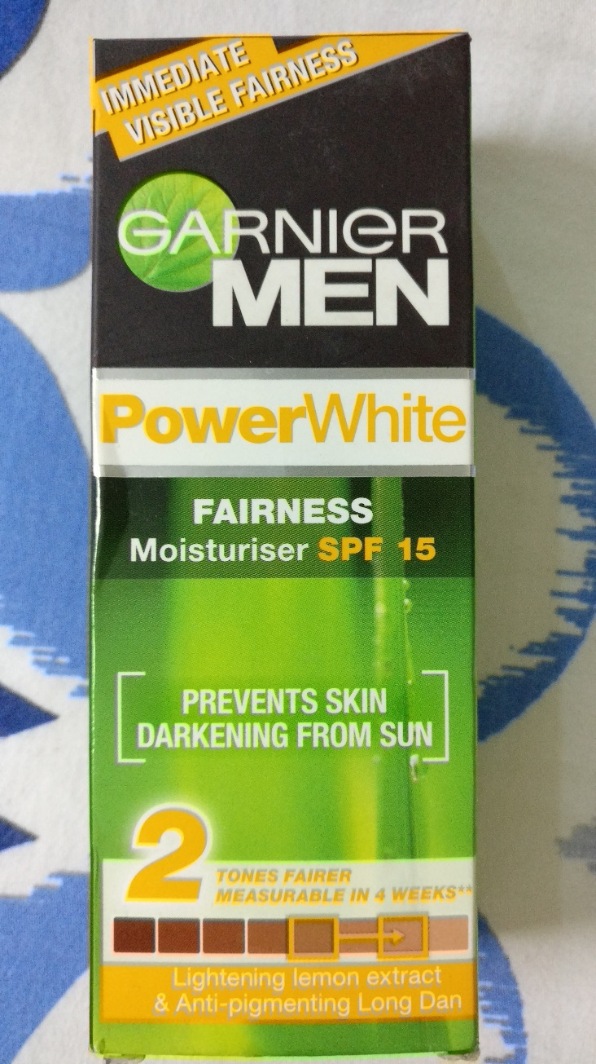


Hypothesis tests give a way of using samples to test whether statistical claims are likely to be true or not.
“The first problem for all of us, men and women, is not to learn, but to unlearn.” – Gloria Steinem

Slide 5
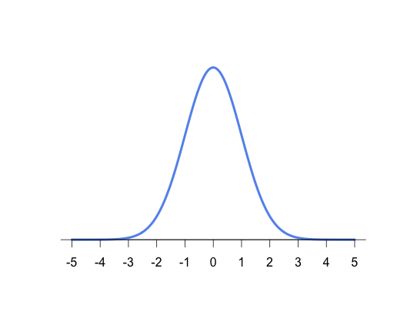
Hypothesis Testing Process
Claim or Expectation, say, 2 tones of fairness
This far?
This far?
This far?
“People learn something every day, and a lot of times it's that what they learned the day before was wrong.” – Bill Vaughan

Slide 6
Hypothesis Testing 5 STEP Process
Decide on the hypothesis
Specify the critical region
Find the p-value
Is the sample result in the critical region?
Make your decision
“People learn something every day, and a lot of times it's that what they learned the day before was wrong.” – Bill Vaughan

Slide 7
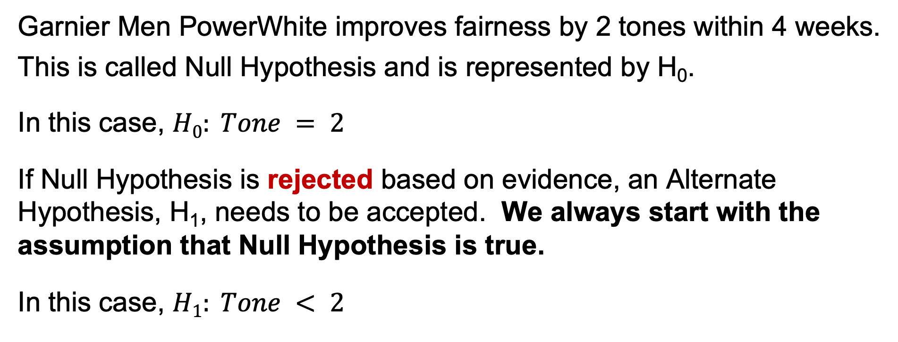
Step 1: Decide on the hypothesis
Garnier Men PowerWhite improves fairness by 2 tones within 4 weeks.
This is called Null Hypothesis and is represented by H₀.
In this case, $H0: Tone = 2$
If Null Hypothesis is rejected based on evidence, an Alternate Hypothesis, H₁, needs to be accepted. We always start with the assumption that Null Hypothesis is true.
In this case, $H1: Tone < 2$
Decide on the hypothesis
Specify the critical region
Find the p-value
Is the sample result in the critical region?
Make your decision
“Many highly intelligent people are poor thinkers. Many people of average intelligence are skilled thinkers…

Slide 8

Step 1: Decide on the hypothesis
Garnier Men PowerWhite improves fairness by 2 tones within 4 weeks.
This is called Null Hypothesis and is represented by H₀.
In this case, $H0: Tone = 2$
If Null Hypothesis is rejected based on evidence, an Alternate Hypothesis, H₁, needs to be accepted. We always start with the assumption that Null Hypothesis is true.
In this case, $H1: Tone < 2$
Decide on the hypothesis
Specify the critical region
Find the p-value
Is the sample result in the critical region?
Make your decision
“Many highly intelligent people are poor thinkers. Many people of average intelligence are skilled thinkers…

Slide 9
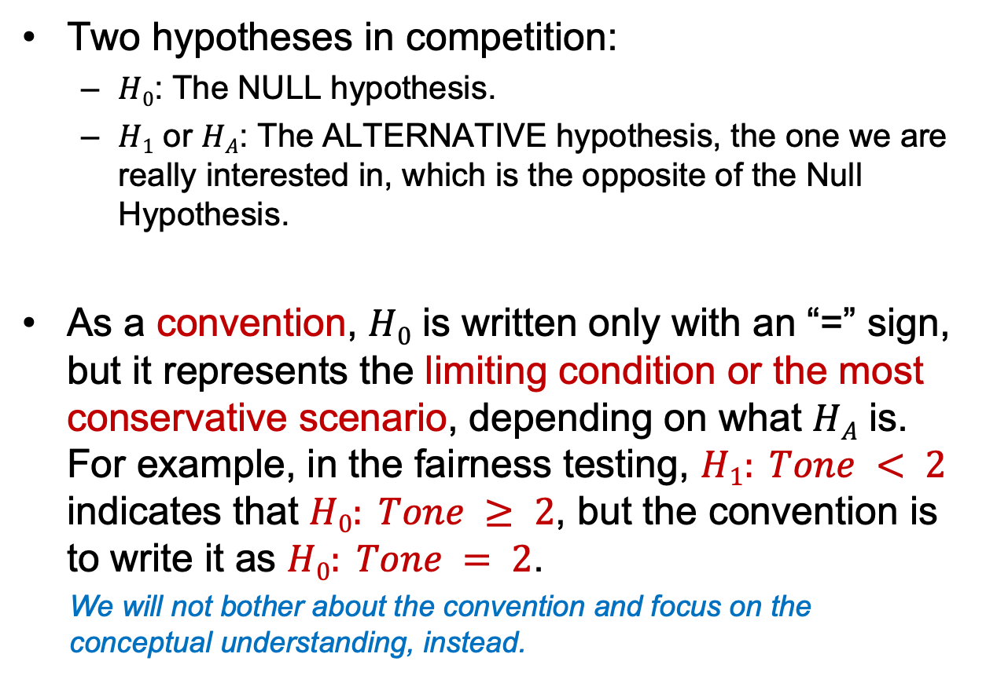
Null vs Alternative Hypotheses
Two hypotheses in competition:
$H0$: The NULL hypothesis.
$H1$ or $HA$: The ALTERNATIVE hypothesis, the one we are really interested in, which is the opposite of the Null Hypothesis.
As a convention, $H0$ is written only with an “=” sign, but it represents the limiting condition or the most conservative scenario, depending on what $HA$ is. For example, in the fairness testing, $H1: Tone < 2$ indicates that $H0: Tone ≥ 2$, but the convention is to write it as $H0: Tone = 2$.
We will not bother about the convention and focus on the conceptual understanding, instead.
2 tones of fairness
…The power of the car is separate from the way the car is driven.” – Edward de Bono

Slide 10
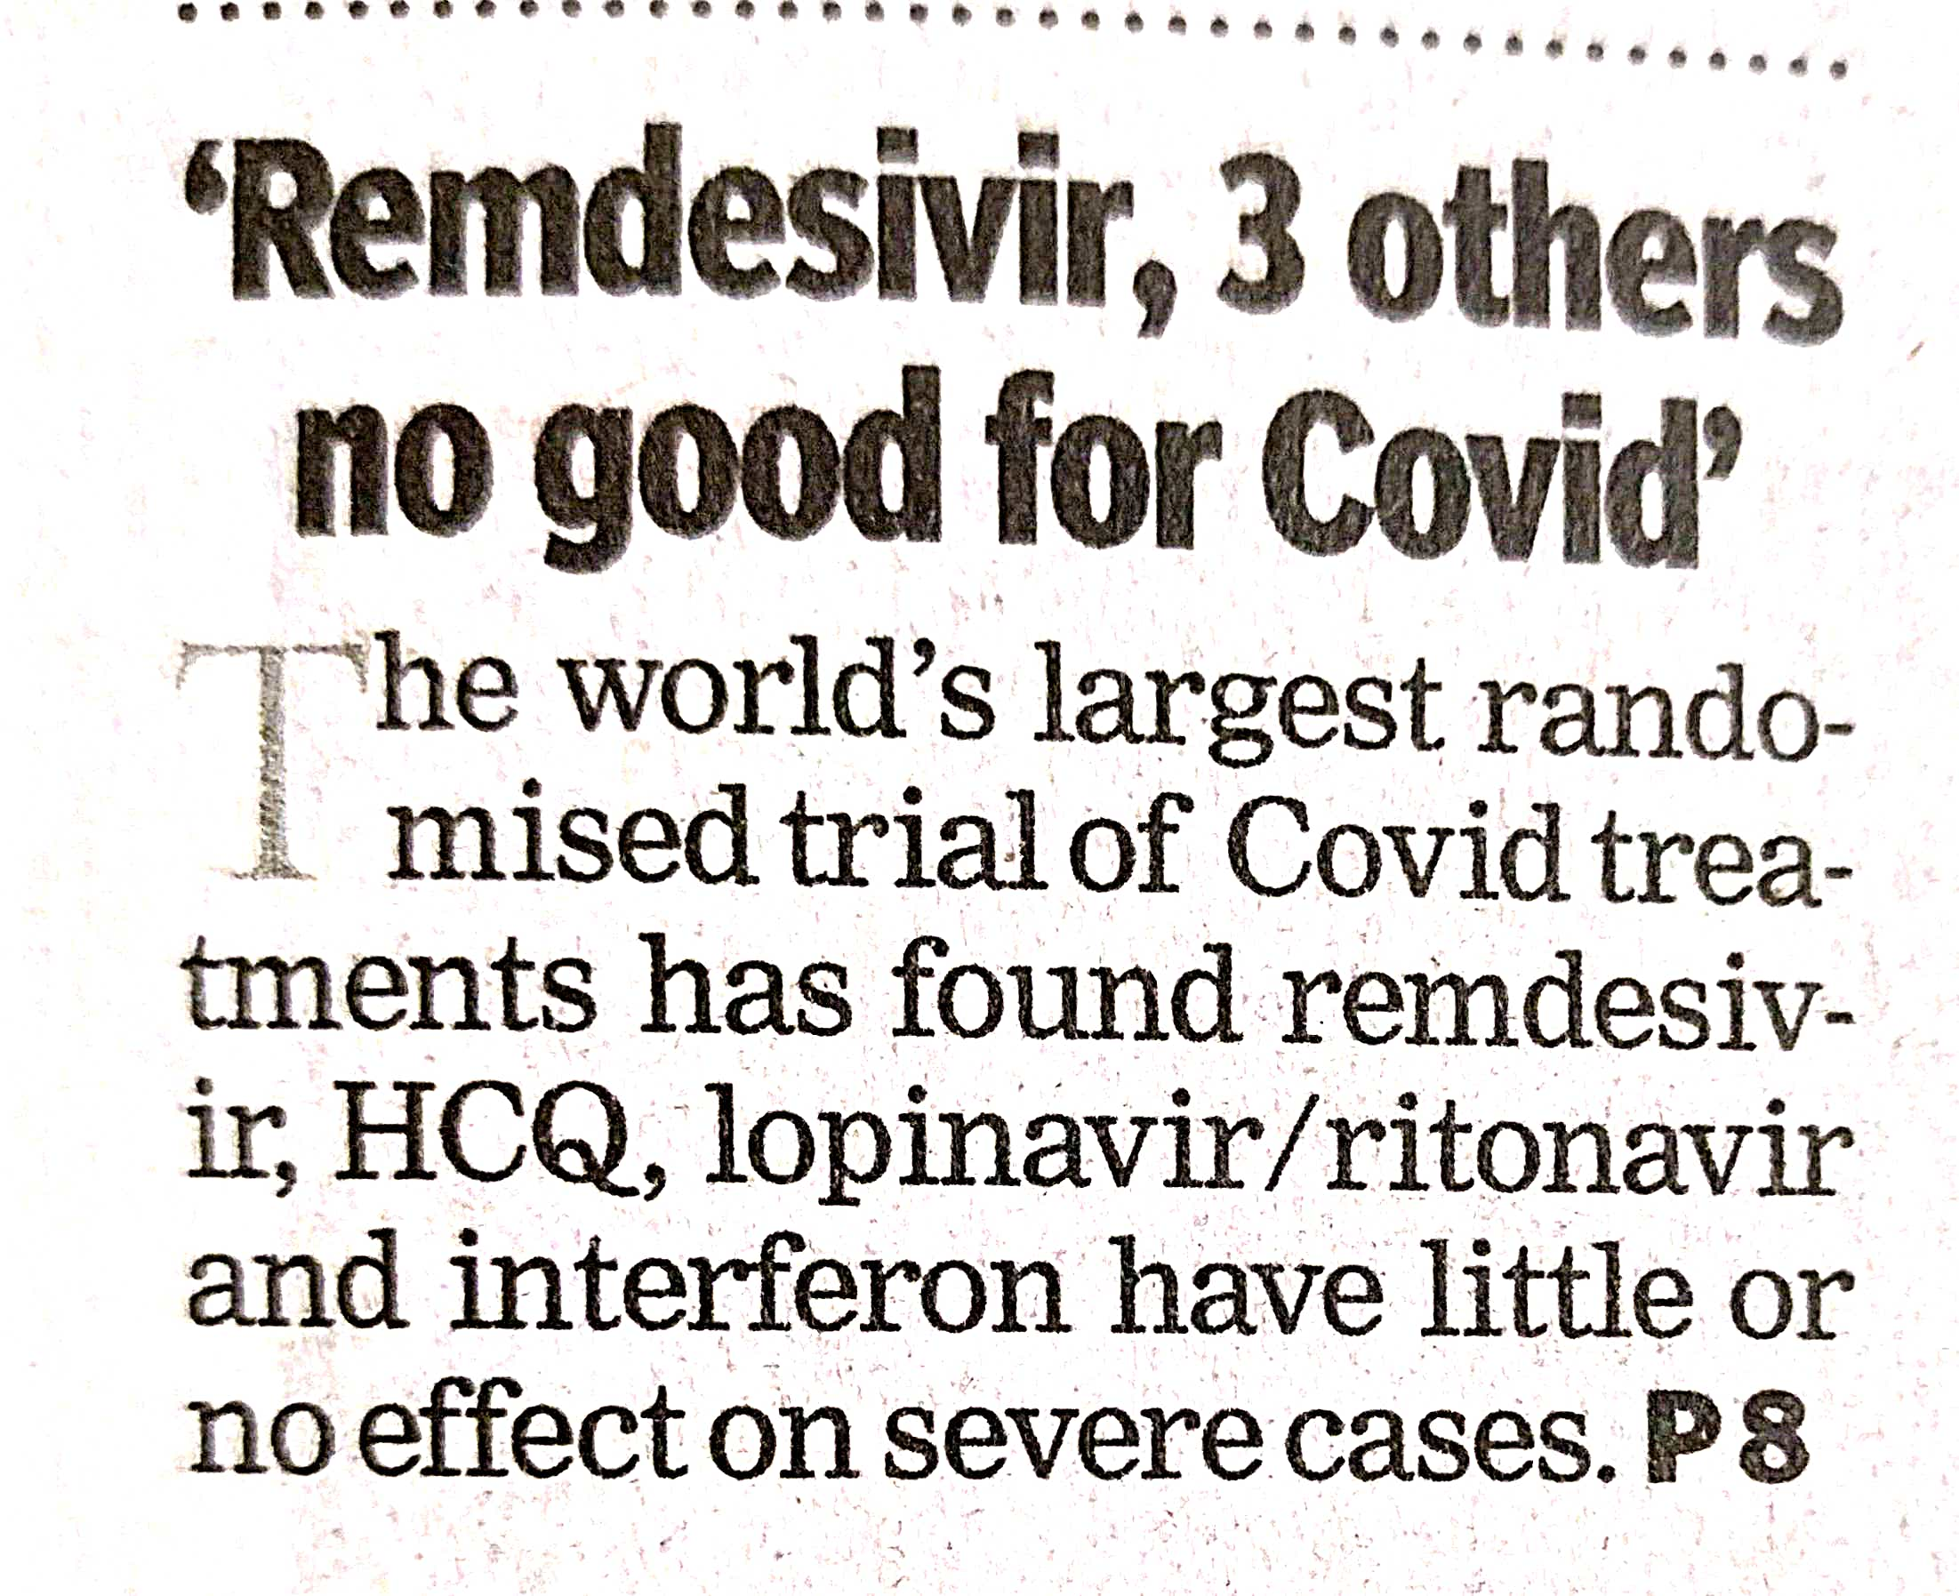
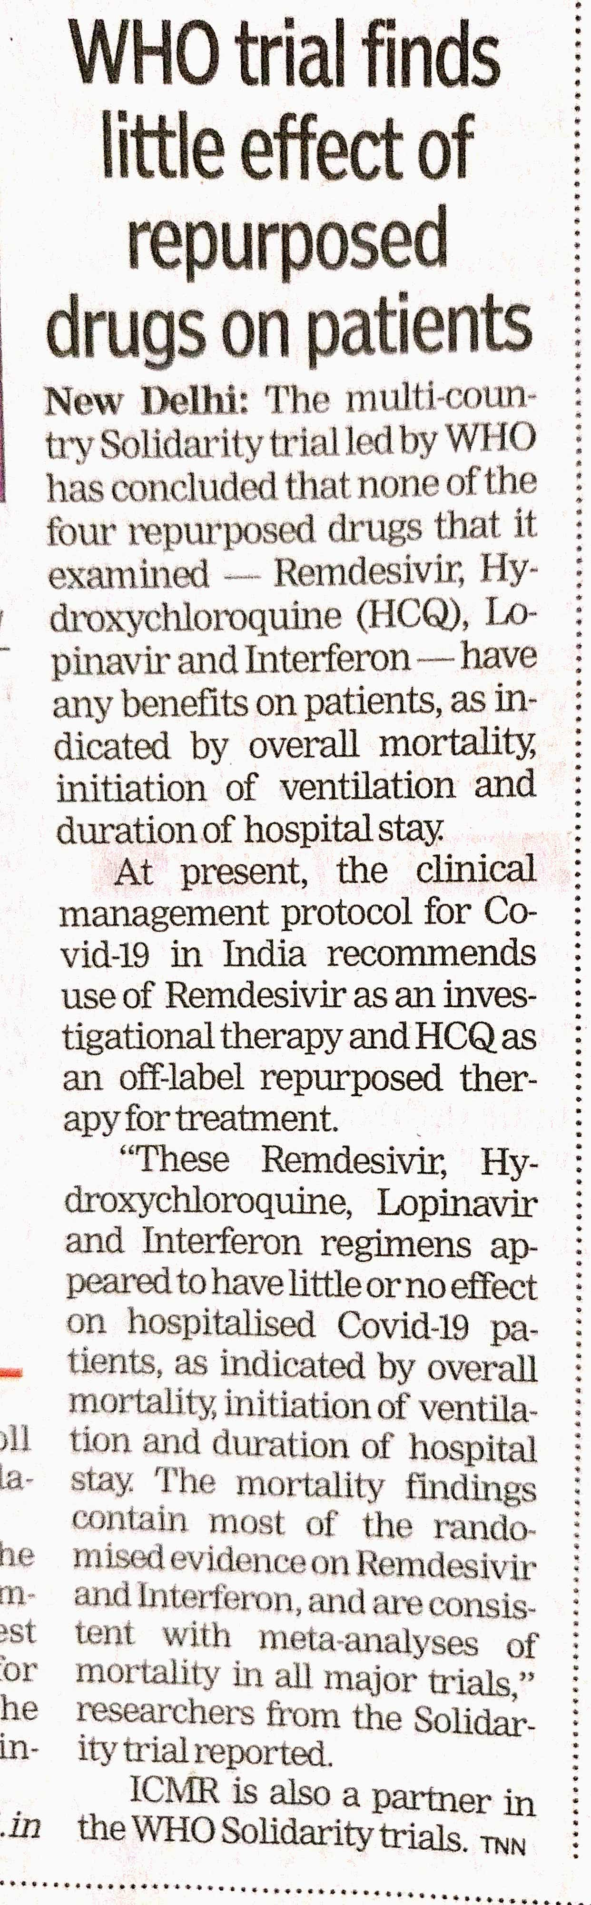
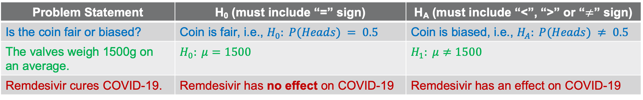
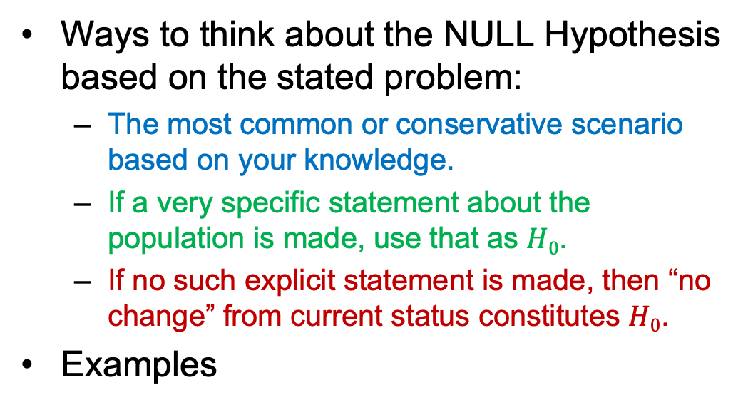
Examples of Hypotheses
Ways to think about the NULL Hypothesis based on the stated problem:
The most common or conservative scenario based on your knowledge.
If a very specific statement about the population is made, use that as $H0$.
If no such explicit statement is made, then “no change” from current status constitutes $H0$.
Examples
Problem Statement | H₀ (must include “=” sign) | H_{A} (must include “<”, “>” or “$≠$” sign)
Is the coin fair or biased? | Coin is fair, i.e., $H_{0}: P(Heads) = 0.5$ | Coin is biased, i.e., $H_{A}: P(Heads) ≠ 0.5$
The valves weigh 1500g on an average. | $$H_{0}: μ=1500$$ | $$H_{1}: μ≠1500$$
Remdesivir cures COVID-19. | Remdesivir has no effect on COVID-19 | Remdesivir has an effect on COVID-19
“I've learned… that the best classroom in the world is at the feet of an elderly person.” – Andy Rooney

Slide 11
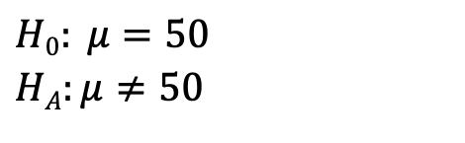
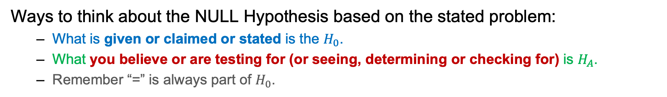
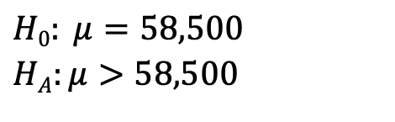
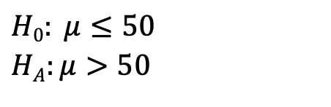
Examples of Hypotheses
Ways to think about the NULL Hypothesis based on the stated problem:
What is given or claimed or stated is the $H_{0}$.
What you believe or are testing for (or seeing, determining or checking for) is $H_{A}$.
Remember “=” is always part of $H_{0}$.
State Null and Alternate Hypotheses for the following:
You are testing if the mean speed of your broadband internet connection is 50Mbps.
$$H0: μ=50$$
$$HA:μ≠50$$
You are testing if the mean speed of your broadband internet connection is more than 50Mbps.
$$H0: μ≤50$$
$$HA:μ>50$$
The mean entry level salary of an employee at a company is $58,000. You believe it is higher for IT professionals in the company.
$$H0: μ=58,500$$
$$HA:μ>58,500$$
Ref: Introductory Statistics, Barbara Illowsky and Susan Dean, OpenStax, Rice University
“If we knew what it was we were doing, it would not be called research, would it?” – Albert Einstein

Slide 12
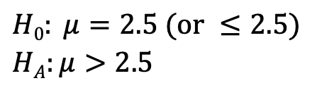
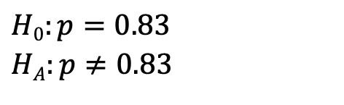
Examples of Hypotheses
State Null and Alternate Hypotheses for the following:
A sociologist claims the probability that a person picked at random in Times Square in New York City is visiting the area is 0.83. You want to test to see if the claim is correct.
$$H0:p=0.83$$
$$HA:p≠0.83$$
Suppose that a recent article stated that the mean time spent in jail by a first–time convicted burglar is 2.5 years. A study was then done to see if the mean time has increased in the new century. A random sample of 26 first-time convicted burglars in a recent year was picked. The mean length of time in jail from the survey was 3 years with a standard deviation of 1.8 years. Suppose that it is somehow known that the population standard deviation is 1.5. If you were conducting a hypothesis test to determine if the mean length of jail time has increased, what would the null and alternative hypotheses be? The distribution of the population is normal.
$$H0: μ=2.5 (or ≤2.5)$$
$$HA:μ>2.5$$
Ref: Introductory Statistics, Barbara Illowsky and Susan Dean, OpenStax, Rice University
“That which can be asserted without evidence, can be dismissed without evidence.” – Christopher Hitchens

Slide 13
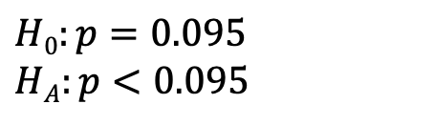
Examples of Hypotheses
State Null and Alternate Hypotheses for the following:
The National Institute of Mental Health published an article stating that in any one-year period, approximately 9.5 percent of American adults suffer from depression or a depressive illness. Suppose that in a survey of 100 people in a certain town, seven of them suffered from depression or a depressive illness. If you were conducting a hypothesis test to determine if the true proportion of people in that town suffering from depression or a depressive illness is lower than the percent in the general adult American population, what would the null and alternative hypotheses be?
$$H0:p=0.095$$
$$HA:p<0.095$$
Ref: Introductory Statistics, Barbara Illowsky and Susan Dean, OpenStax, Rice University
“Everything must be made as simple as possible. But not simpler.” – Albert Einstein

Slide 14
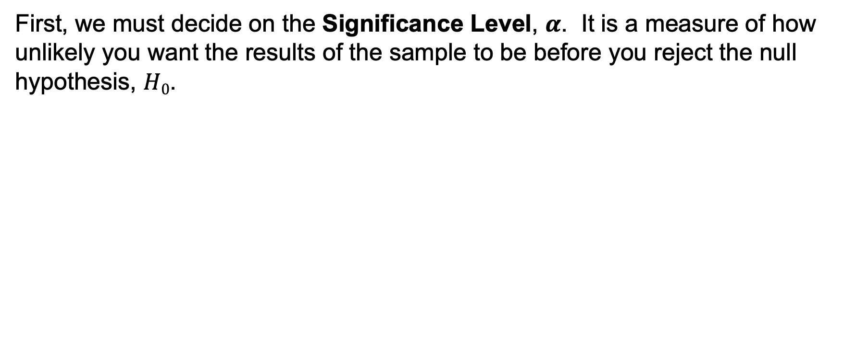
Step 2: Specify the critical region
First, we must decide on the Significance Level, $α$. It is a measure of how unlikely you want the results of the sample to be before you reject the null hypothesis, $H0$.
This far?
This far?
This far?
Decide on the hypothesis
Specify the critical region
Find the p-value
Is the sample result in the critical region?
Make your decision
Claim or Expectation, say, 2 tones of fairness
““What sculpture is to a block of marble education is to the human soul..” – Joseph Addison

Slide 15
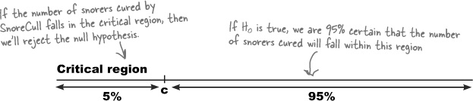
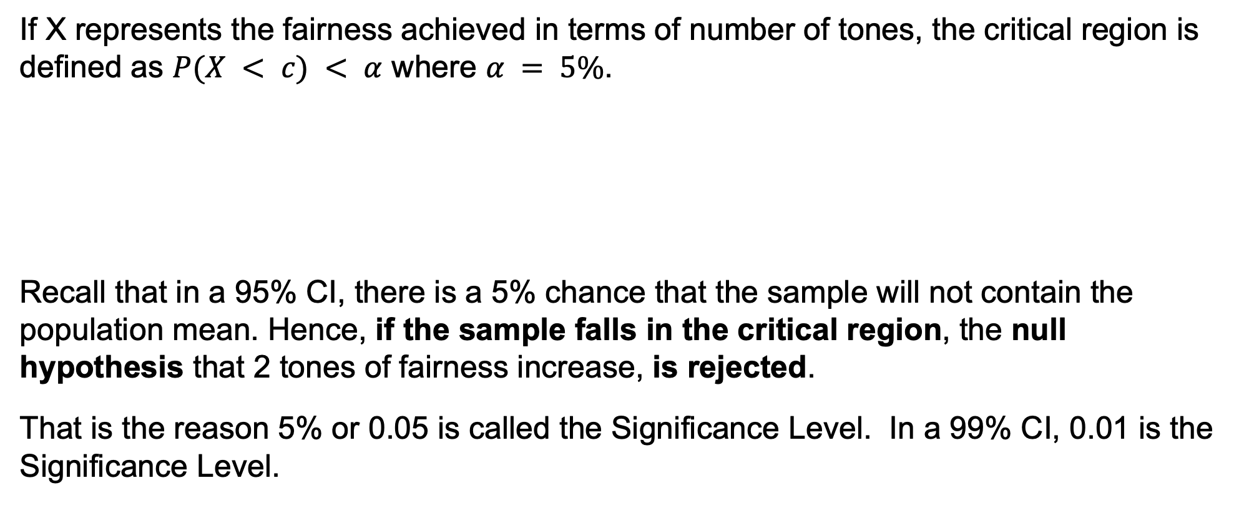
Step 2: Specify the critical region
If X represents the fairness achieved in terms of number of tones, the critical region is defined as $P(X < c) < α$ where $α = 5\%$.
Recall that in a 95% CI, there is a 5% chance that the sample will not contain the population mean. Hence, if the sample falls in the critical region, the null hypothesis that 2 tones of fairness increase, is rejected.
That is the reason 5% or 0.05 is called the Significance Level. In a 99% CI, 0.01 is the Significance Level.
Critical Region
“A well-educated mind will always have more questions than answers.” – Helen Keller

Slide 16
Step 3: Find the p-value
p-value is the probability of getting only by chance a value at least as extreme as the one in the sample under the assumption that the null hypothesis is true.
It is a way of taking the sample and working out whether the result falls within the critical region of the hypothesis test. A value in the critical region indicates presence of a real effect (not just by chance) when the null hypothesis represents presence of no effect.
p-value (pnorm or norm.cdf)
Probability density
Area under the curve
“It is a thousand times better to have common sense without education than to have education without common sense.” – Robert G Ingersoll

Slide 17
Step 4: Is the sample result in the critical region?
Critical Region
5.55%
“There is nothing in a caterpillar that tells you it's going to be a butterfly.” – Buckminster Fuller

Slide 18
Step 5: Make your decision
There isn’t sufficient evidence to reject the null hypothesis and so, the claims of the company are “accepted”.
“Work gets done only through sincere efforts, not by thinking alone. Deer do not enter into the mouth of a sleeping lion.” – Sanskrit Proverb

Slide 19
Attention Check
In hypothesis testing, do you assume null hypothesis to be true or false?
True
If there is sufficient evidence against the null hypothesis, do you “accept” it or reject it?
Reject it
If $p<0.05$ for $α=0.05$, do you “accept” $H_{0}$ or reject it?
Reject it
“If I have seen further it is by standing on the shoulders of Giants.” – Isaac Newton

Slide 20
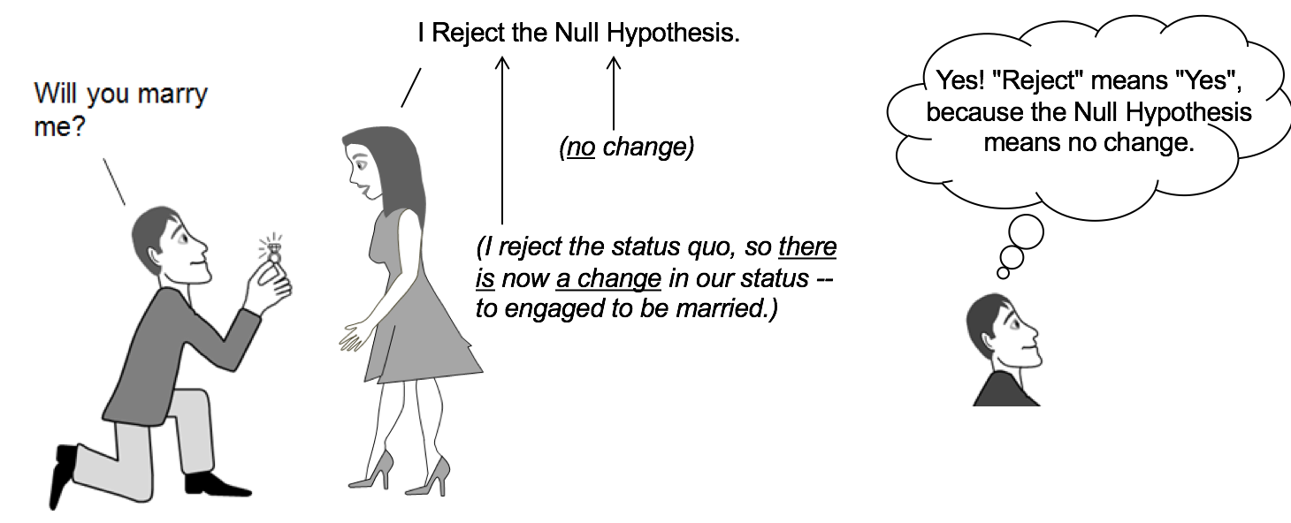

“Those who do not start work at all fearing obstacles are people of low calibre…

Slide 21

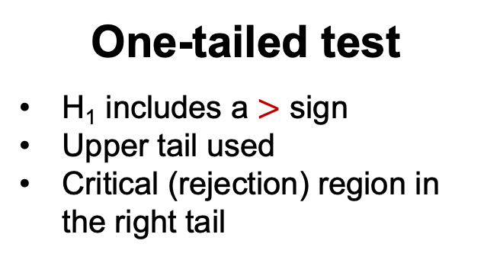
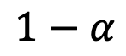


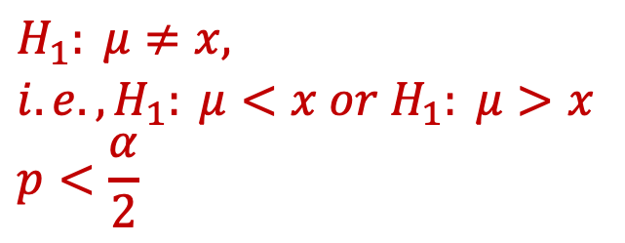

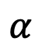
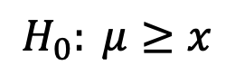

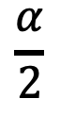
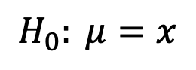

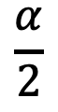
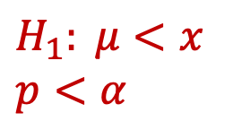


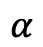
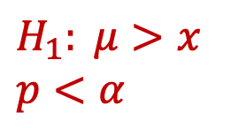
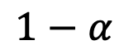
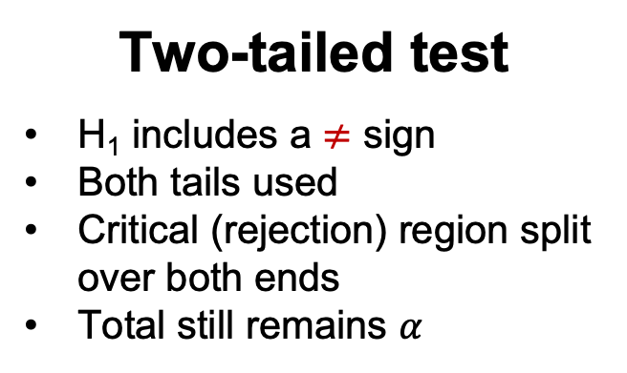
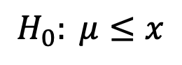

Critical Region Up Close
One-tailed test
H₁ includes a $<$ sign
Lower tail used
Critical (rejection) region in the left tail
One-tailed test
H₁ includes a $>$ sign
Upper tail used
Critical (rejection) region in the right tail
Two-tailed test
H₁ includes a $≠$ sign
Both tails used
Critical (rejection) region split over both ends
Total still remains $α$
$$\frac{α}{2}$$
$$\frac{α}{2}$$
$$1−α$$
$$1−α$$
$$1−α$$
$$α$$
$$μ$$
$$μ$$
$$α$$
$$μ$$
$$H_{1}: μ<x$$
$$p<α$$
$$H_{0}: μ≥x$$
$$H_{0}: μ≤x$$
$$H_{1}: μ>x$$
$$p<α$$
$$H_{0}: μ=x$$
$$H_{1}: μ≠x,$$
$$i.e.,H_{1}: μ<x or{ H}_{1}: μ>x$$
$$p<\frac{α}{2}$$
…Those who start the work but stop midway on encountering obstacles are people of medium calibre…

Slide 22
Critical Region Up Close
For each of the scenarios below, the critical regions are:
Garnier Men PowerWhite hypothesis test as discussed till now (checking whether the result was <2 tones fairer).
One-tailed/Lower-tailed
You want to test if customers spend LESS THAN Rs 2,000 on an average in the vitamins section of your store.
One-tailed/Lower-tailed
You want to test if customers spend MORE THAN Rs 5,000 on an average in the vitamins section of your store.
One-tailed/Upper-tailed
You want to test if customers spend Rs 2,000 on an average in the vitamins section of your store.
Two-tailed test
…Those who do not give up despite being repeatedly pulled down by obstacles are people of high calibre.” – Sanskrit Proverb

Slide 23
The hypothesis test doesn’t answer the question whether the company is telling the truth or not or if Garnier Men PowerWhite really works or not.
It only states whether the evidence is enough to reject the null hypothesis or not at the chosen significance level.
…and a quarter is digested over time (through experience and practice).” – Sanskrit Proverb

Slide 24
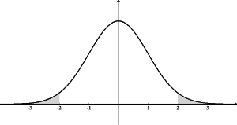
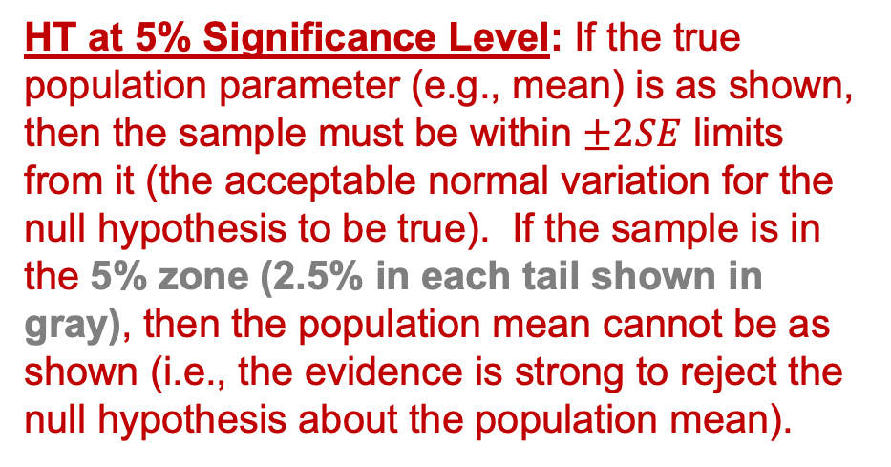
Confidence Intervals and Hypothesis Testing – Two Ways of Inferring the Same
HT at 5% Significance Level: If the true population parameter (e.g., mean) is as shown, then the sample must be within $±2SE$ limits from it (the acceptable normal variation for the null hypothesis to be true). If the sample is in the 5% zone (2.5% in each tail shown in gray), then the population mean cannot be as shown (i.e., the evidence is strong to reject the null hypothesis about the population mean).
-3
-2
-1
Population Mean
1
2
3
95% CI: If the true population parameter (e.g., mean) is as shown, then 95% of the samples will contain it within the range $\overline{x}±2SE$. If the sample is in the 5% zone (2.5% in each tail shown in gray), then the true population parameter cannot be as shown (i.e., it will not lie in the range $\overline{x}±2SE$.)
“Wealth in the form of knowledge cannot be stolen, cannot be usurped by a king, cannot be divided among brothers, and is not a burden…

Slide 25
Inferential Techniques
Goal: Make an inference about an unknown population based on a sample taken from that population.
Approach 1: CONFIDENCE INTERVALS
Calculate sample mean, $\overline{x}$.
Assign a margin of error within which to expect the population mean with a certain confidence.
$\overline{x}−z∗\frac{σ}{\sqrt{n}}<μ<\overline{x}+z∗\frac{σ}{\sqrt{n}}$
0.975
0.025
qnorm or norm.ppf(0.975,0,1) = 1.96
95% Confidence Level
|z| = 1.96
qnorm or norm.ppf(0.025,0,1) = -1.96
qnorm or norm.ppf(0.95,0,1) = 1.645
90% Confidence Level
|z| = 1.645
qnorm or norm.ppf(0.05,0,1) = -1.645
…It constantly increases on sharing (spending). Knowledge is the greatest wealth of all.” – Sanskrit Proverb

Slide 26
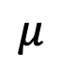
Inferential Techniques
Goal: Make an inference about an unknown population based on a sample taken from that population.
Approach 2: HYPOTHESIS TESTING
Assign a value to the population mean, $μ$. This is your null hypothesis, $H_{0}$.
Decide Significance Level, $α$ (generally, 0.05).
Compute p-value for the sample.
If $p<α$, reject $H_{0}$; else, fail to reject (“accept”) $H_{0}$.
0.025
$$μ$$
$$α=0.05$$
In a 2-tailed test, reject $H_{0} if p<0.025$
“You've got to get up every morning with determination if you're going to go to bed with satisfaction.” – George Lorimer

Slide 27
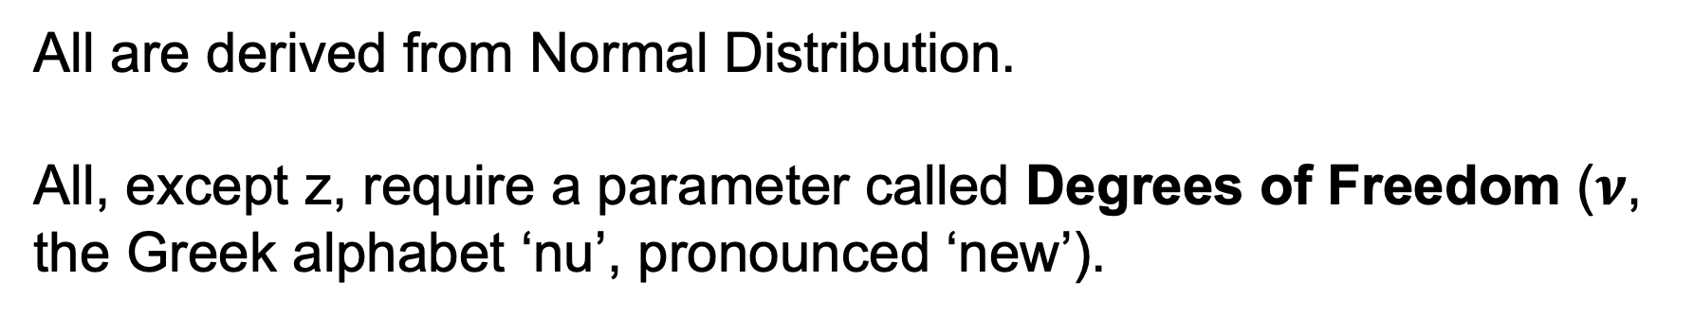
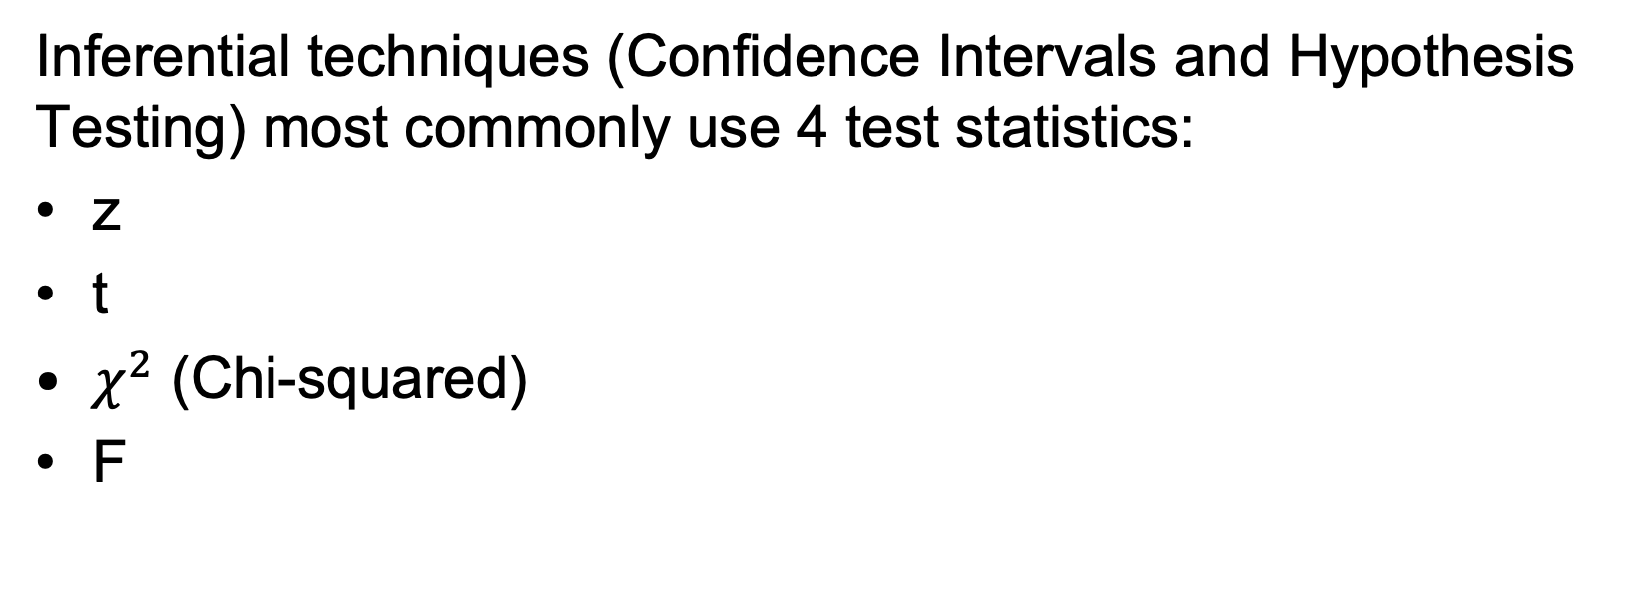
Common Test Statistics for Inferential Techniques
Inferential techniques (Confidence Intervals and Hypothesis Testing) most commonly use 4 test statistics:
z
t
$χ^{2}$ (Chi-squared)
F
Closely related to Sampling Distribution of Means
Closely related to Sampling Distribution of Variances
All are derived from Normal Distribution.
All, except z, require a parameter called Degrees of Freedom ($ν$, the Greek alphabet ‘nu’, pronounced ‘new’).
“You don’t have to be great to start, but you have to start to be great.” – Zig Ziglar

Slide 28
Degrees of Freedom
INFERENTIAL STATISTICS

Slide 29

Degrees of Freedom
Experiment | Number | Question asked | Pieces of information possible from experiment | Piece(s) of information given (without disclosing the answer) | Answer | Degrees of Freedom (df): # of independent pieces of information needed to give correct answer
Coin toss | 100 | What is the # of tails? | 2 # of heads # of tails | 1 53 heads | 47 (you know this automatically and do not have to be told) | 1 (=2-1)
Roll of a die | 1 | What was rolled? | 6 outcomes (1, 2, 3, 4, 5 or 6) | 3 not 1 not 2 not 4 |  | 5 (=6-1)
Seats on a tour bus | 30 | How many people have a freedom to select a seat? | - | - | 29 (the last person must sit in the last available seat and has no freedom to pick) | 29 (=30-1)
“A ship is always safe at shore but that is not what it’s built for.” – Albert Einstein

Slide 30
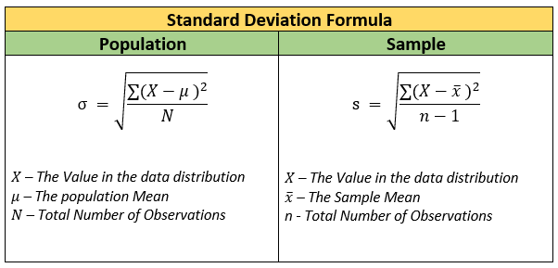
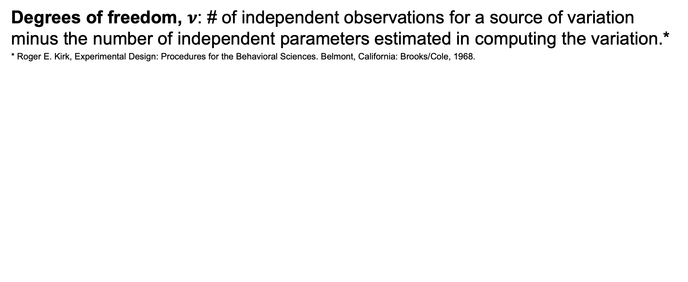
Degrees of Freedom
Degrees of freedom, $ν$: # of independent observations for a source of variation minus the number of independent parameters estimated in computing the variation.*
* Roger E. Kirk, Experimental Design: Procedures for the Behavioral Sciences. Belmont, California: Brooks/Cole, 1968.
When sample size is considered during estimations, degrees of freedom are n-1.
“Stress is caused by being ‘here' but wanting to be ‘there’.” – Eckhart Tolle

Slide 31
LO10.1 – Be able to explain sampling distribution of means and Central Limit Theorem
LO10.2 – Be able to explain the relationship of mean and standard error of the sampling distribution of means with mean and standard deviation of the population
LO10.3 – Be able to explain the purpose of the standard error
LO11 – Understand Confidence Levels and Confidence Intervals
LO11.1 – Be able to define Confidence Levels and Confidence Intervals in statistics and give some real-world examples
LO11.2 – Be able to explain the connection and difference between Standard Error and Margin of Error
LO11.5 – Be able to calculate the confidence intervals on the basis of point estimate (sample statistic) and margin of error
LO11.6 – Be able to compute and interpret the confidence intervals for means and proportions
LO12 – Understand Hypothesis Testing
LO12.1 – Be able to define Hypothesis Testing and give some real-world examples
LO12.2 – Be able to explain Null and Alternative hypotheses and Significance Level
LO12.3 – Be able to define p-value
LO12.3 – Be able to take decisions on rejection (or failure thereof) of a null hypothesis based on the p-value
LO12.4 – Be able to explain the differences in inferential approaches of Confidence Intervals and Hypothesis Testing
LO14.4 – Be able to provide a simple definition and/or explanation of degrees of freedom and compute them in various problems
“Example is not the main thing in influencing others. It is the only thing.” – Albert Schweitzer

Slide 32






Email: info@insofe.edu.in
Website: www.insofe.edu.in
Follow us on Social Media:
/insofeglobal/
/school/insofe/
/INSOFEedu
/insofe_global/
/InsofeVideos
This presentation may contain references to findings of various reports available in the public domain. INSOFE makes no representation as to their accuracy or that the organization subscribes to those findings.

